Slide 1

MindCare
Empowering Your Mind,Elevating your Life-Where Wellbeing Begins.
Team Members:
Ananya Sharma
Syed Kaif Ahmed
Suyash Shinde

Slide 2
Features of the Project
Daily tasks | Enable users to create, manage, and track daily tasks for improved productivity and organization.
Motivational Thoughts | Provide users with daily inspirational quotes or messages to boost morale and positivity.
Exercise tasks | Offer personalized exercise recommendations to promote physical well-being and a healthy lifestyle.
Motivational / Relaxing music | Integrate soothing background music to create a calming and uplifting environment on the website.
Mood Tracking | Allow users to log and monitor their mood patterns to better understand and manage their mental well-being.

Slide 3
Technology Stack
Frontend | Backend | Database
React.JS | SpringBoot | Mongodb
Tailwind CSS
Typescript

Slide 4
User Modules

Slide 5
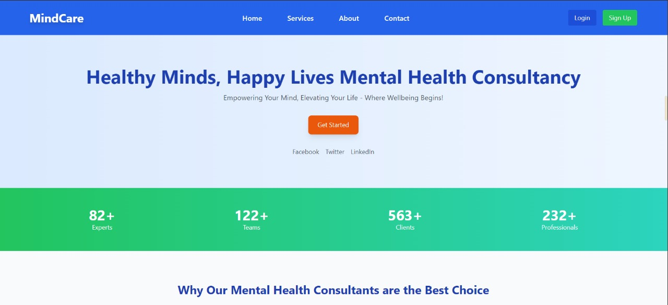
Home Page

Slide 6
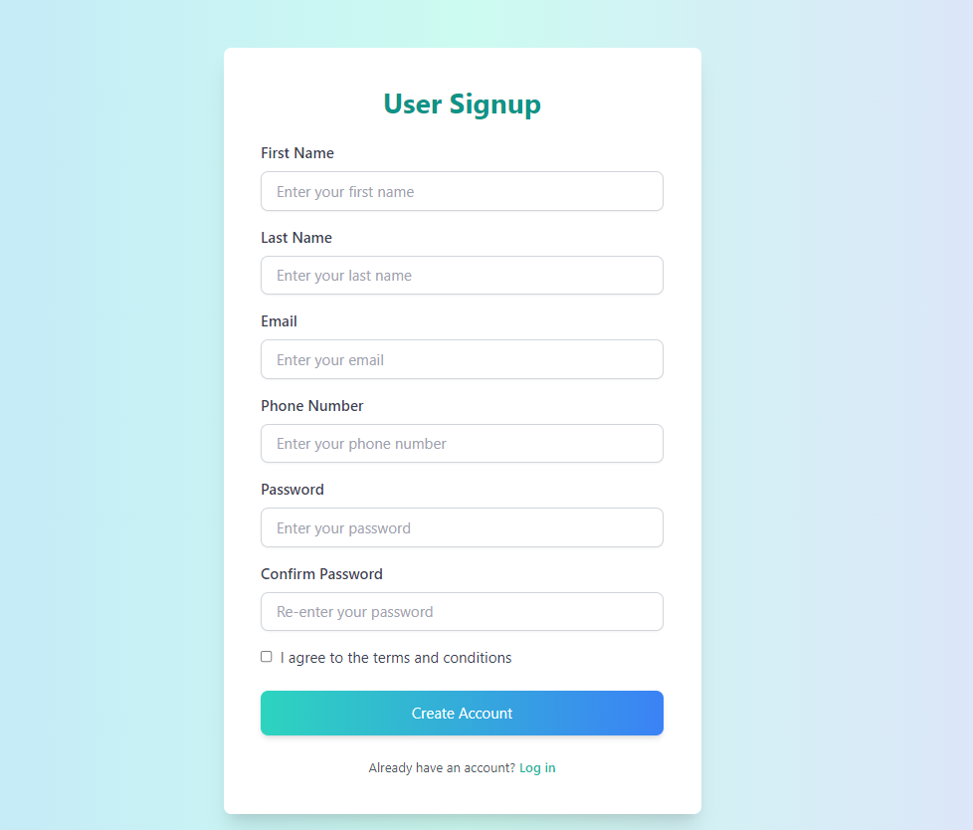
User Registration Page

Slide 7
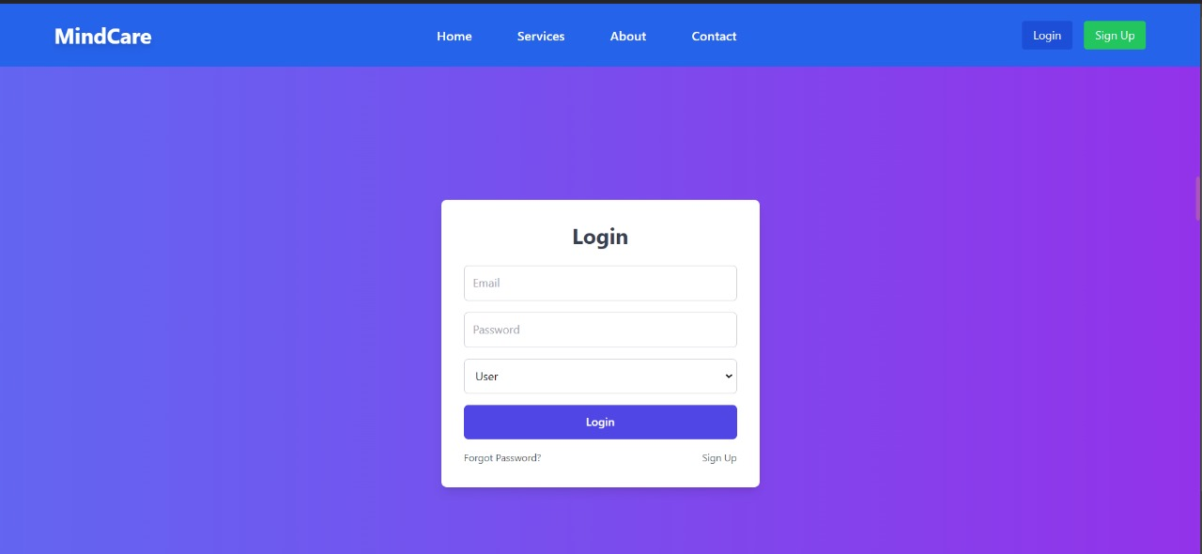
User Login Page

Slide 8
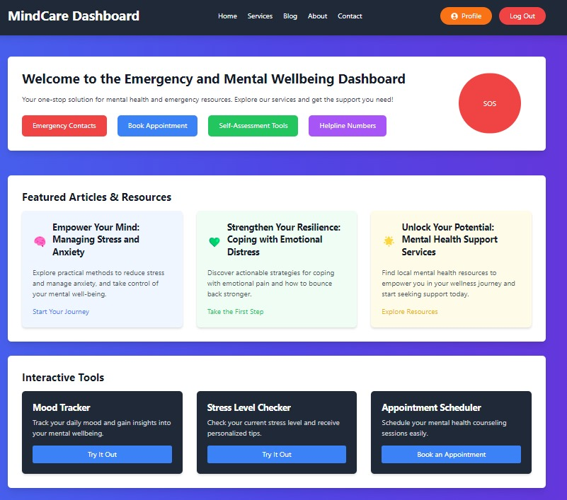
User Dashboard Page

Slide 9
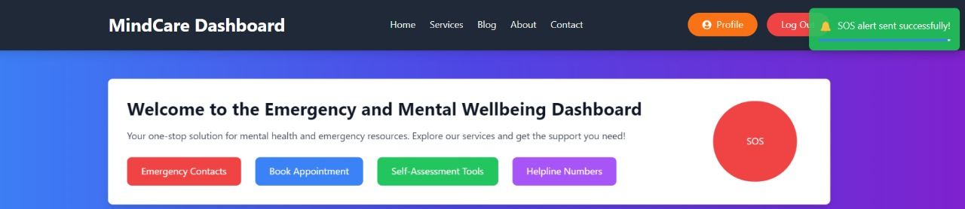
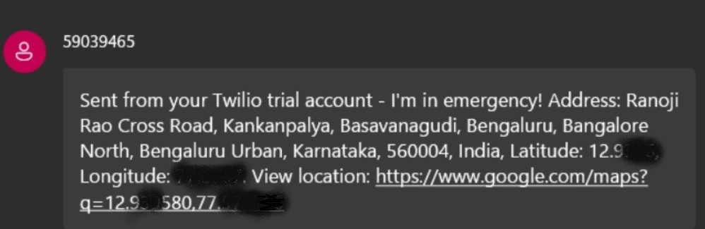
User Dashboard Page (SOS Alert)

Slide 10
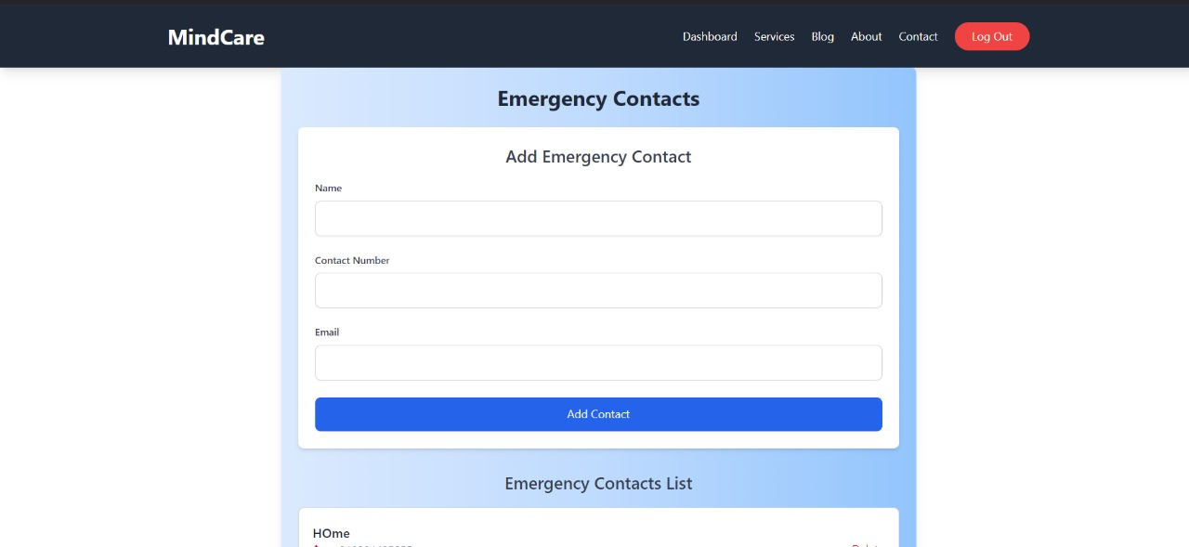
Emergency Contacts

Slide 11
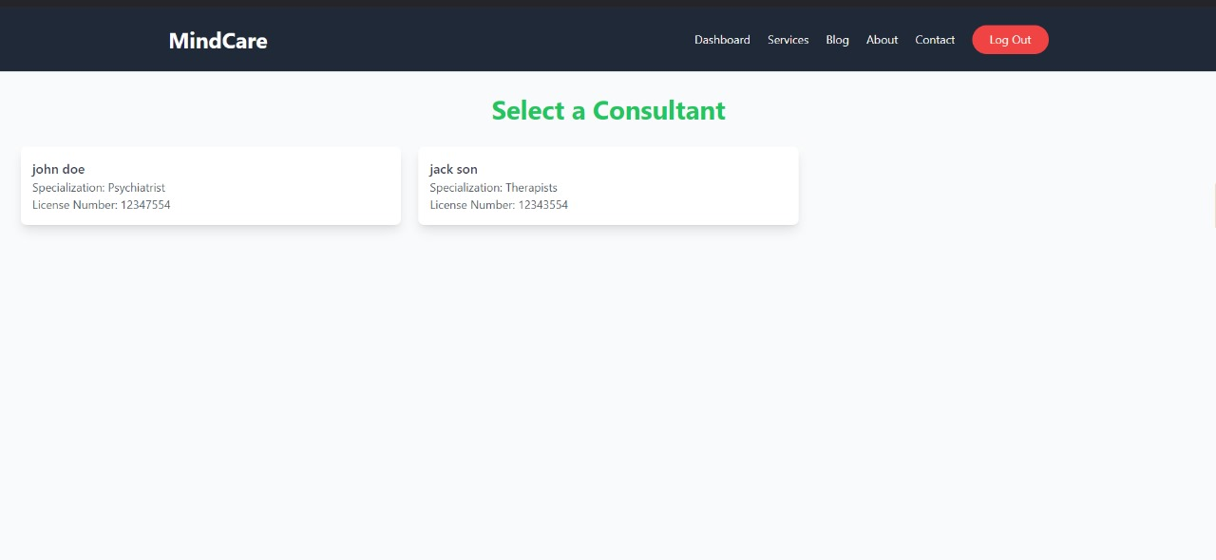
Book Appointment

Slide 12
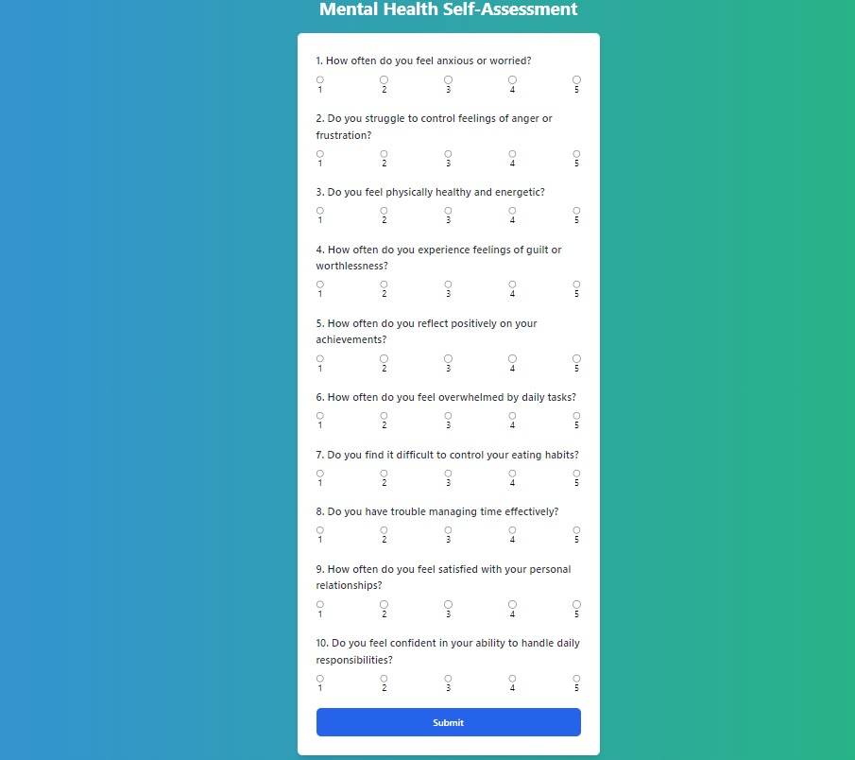
Self Assessment Tools

Slide 13
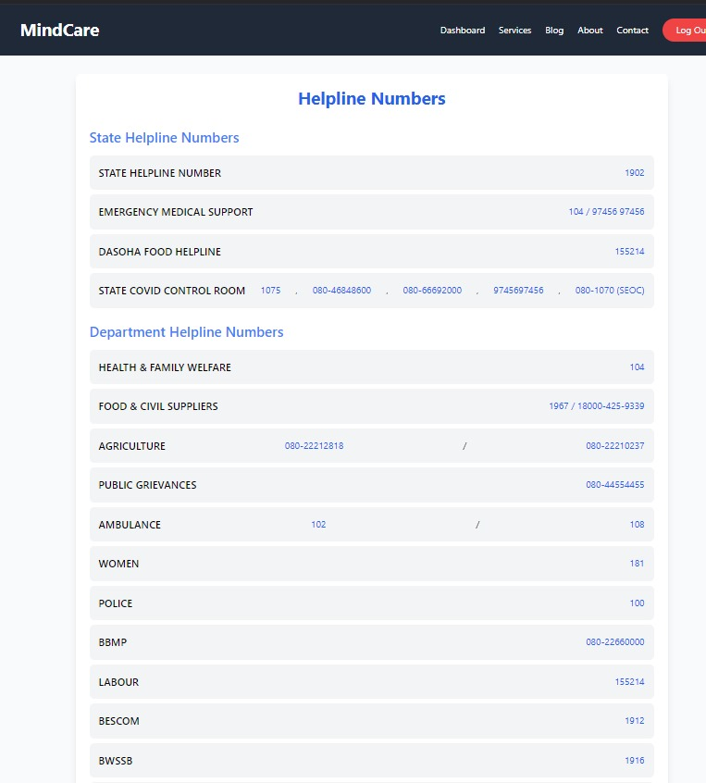
Help Line Numbers

Slide 14
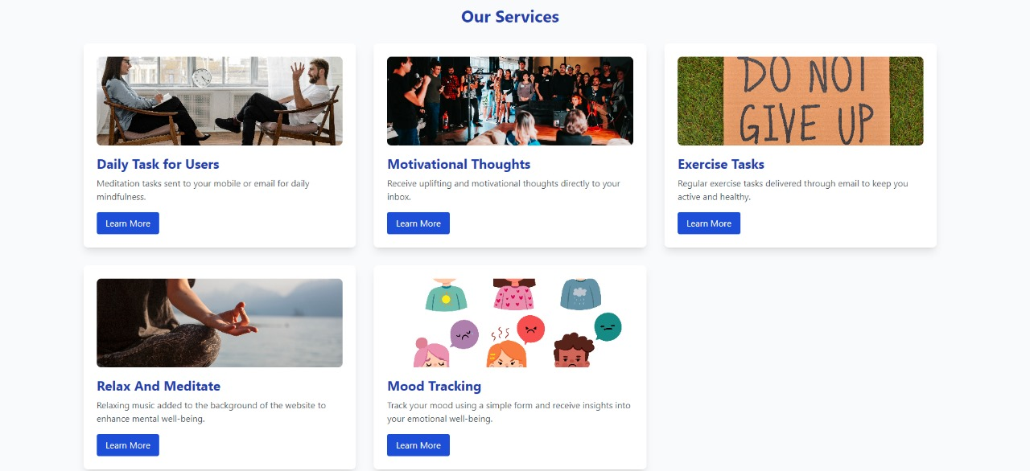
User Services Page

Slide 15
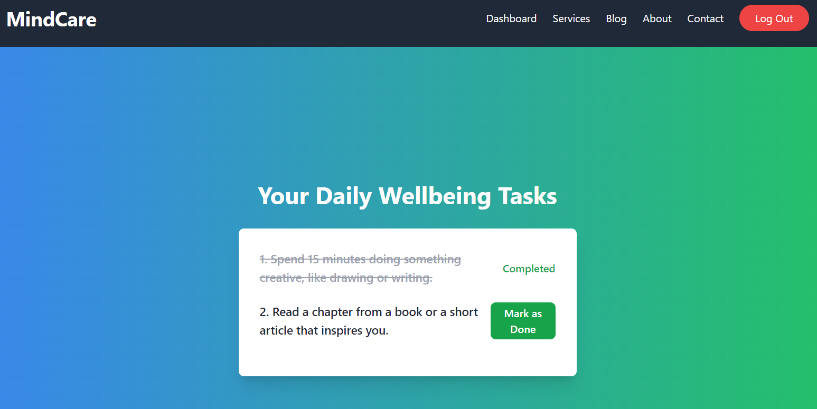
Service 1 : Daily Tasks

Slide 16
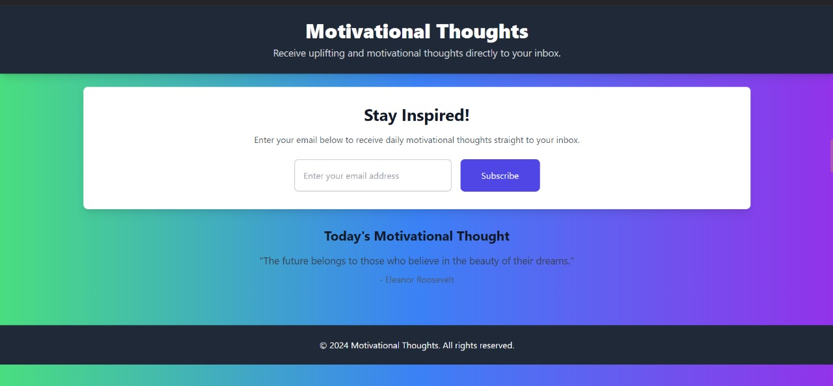
Service 2 : Motivational Thoughts

Slide 17
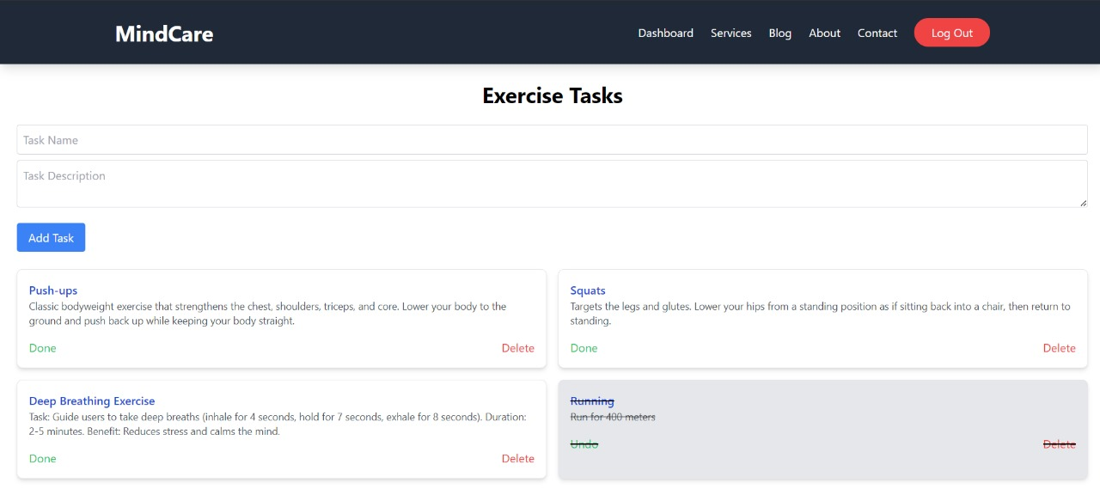
Service 3 : Exercise Tasks

Slide 18
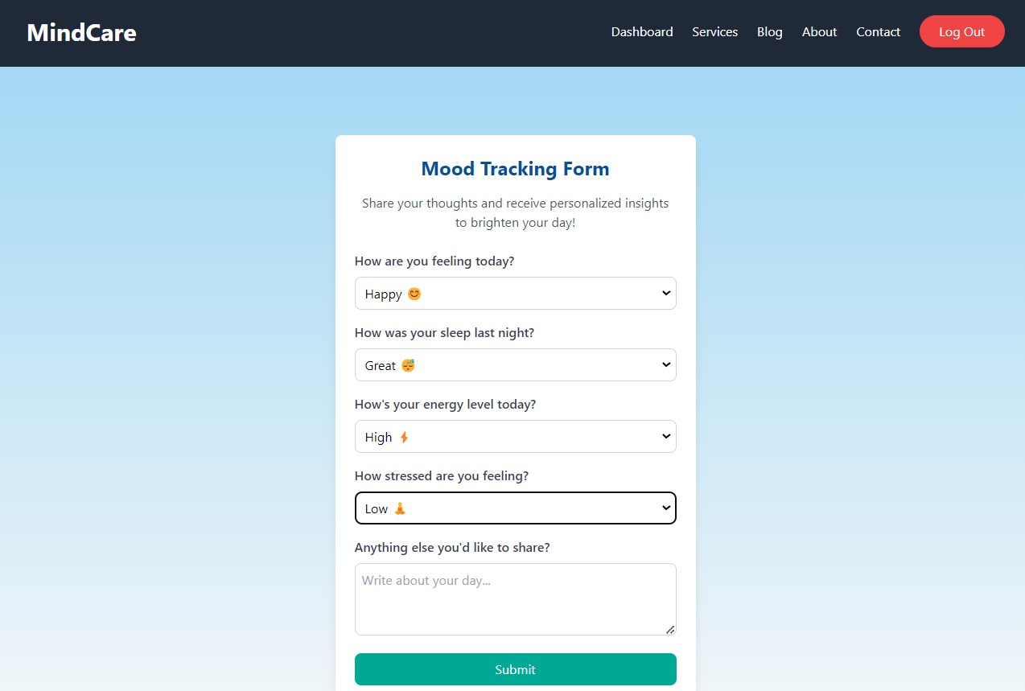
Service 4: Mood Tracker

Slide 19
Consultant Modules

Slide 20
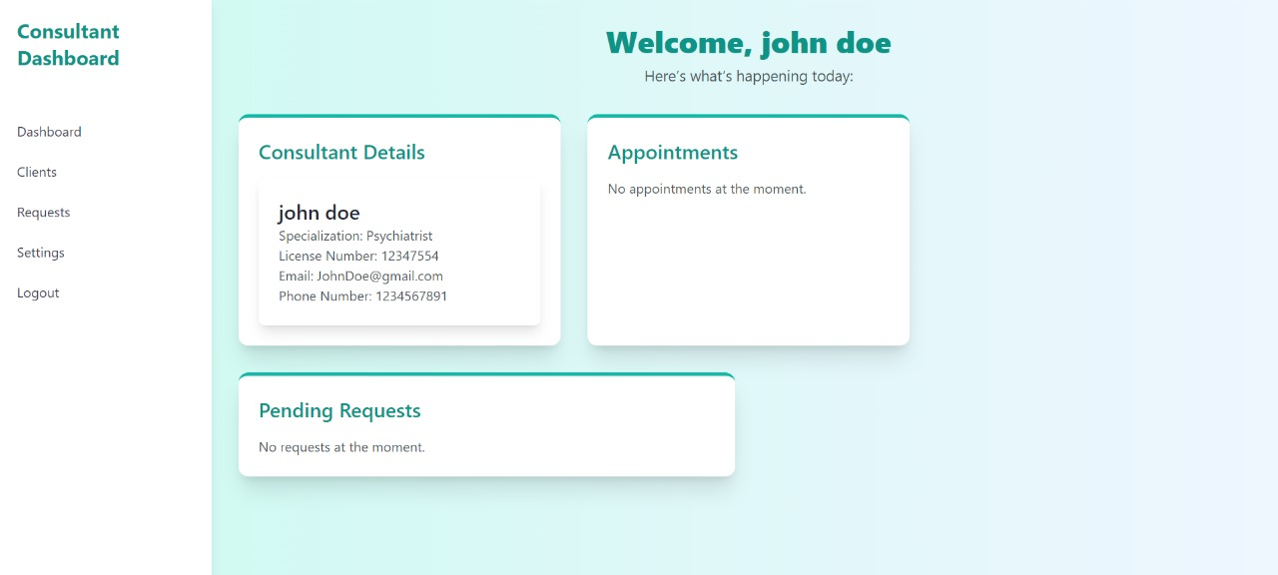
Consultant Dashboard

Slide 21
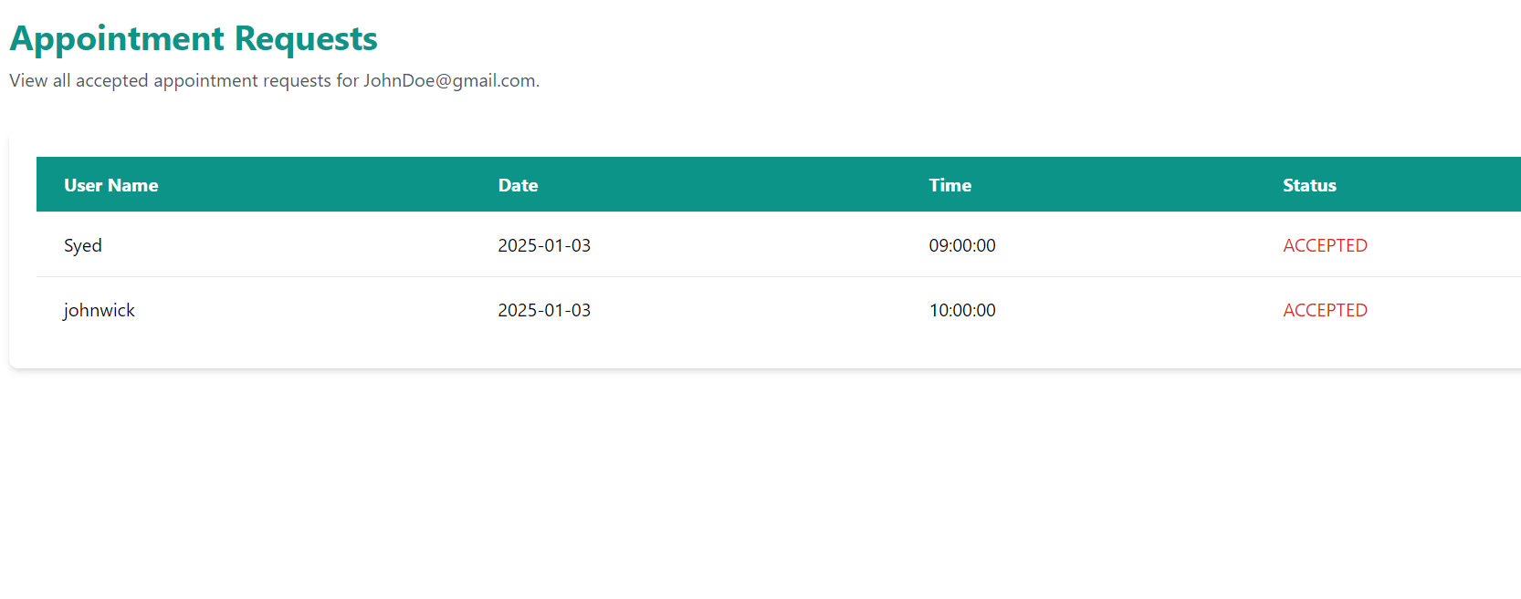
Clients Page

Slide 22
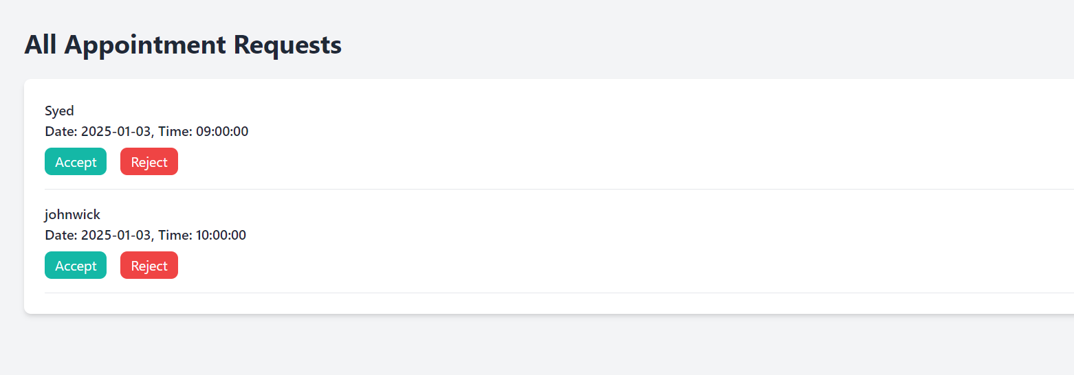
Requests Page

Slide 23
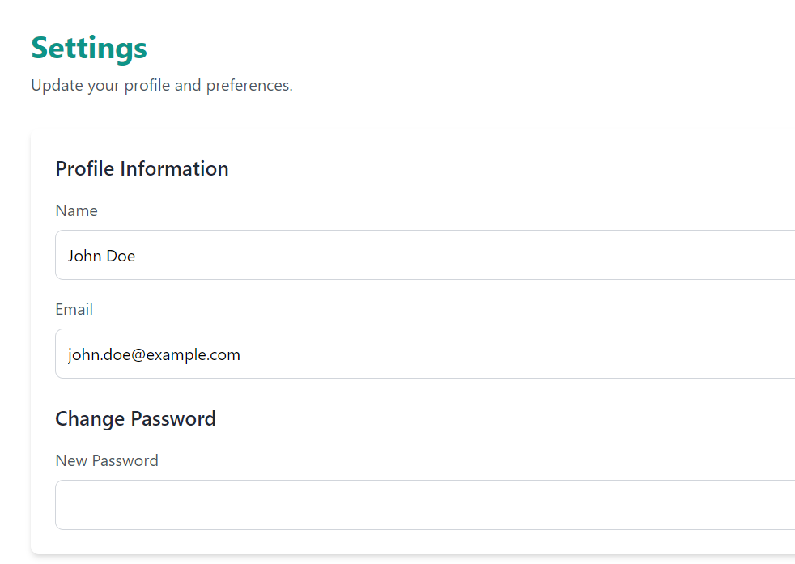
Settings Page

Slide 24
Other Pages

Slide 25
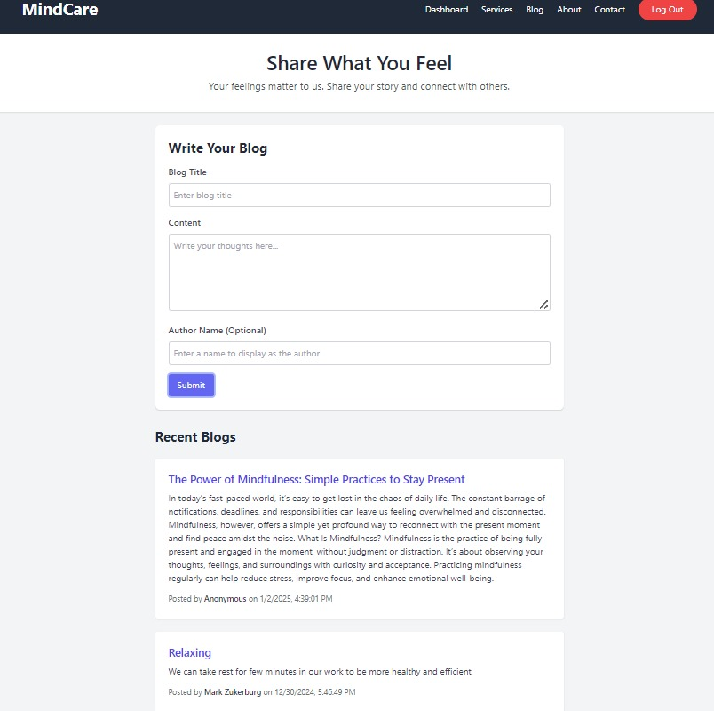
Blog Page

Slide 26
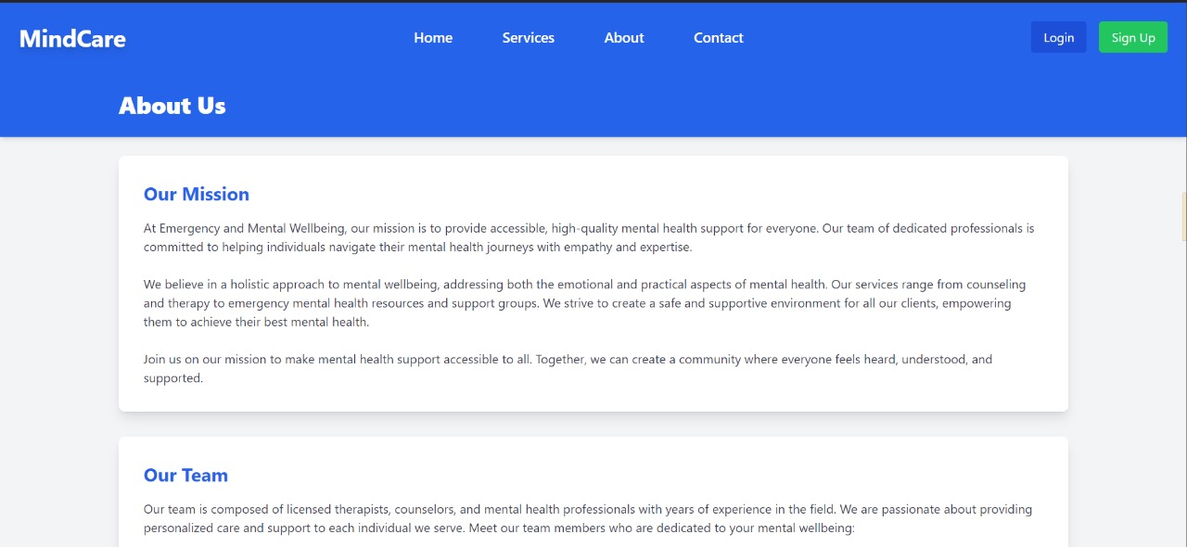
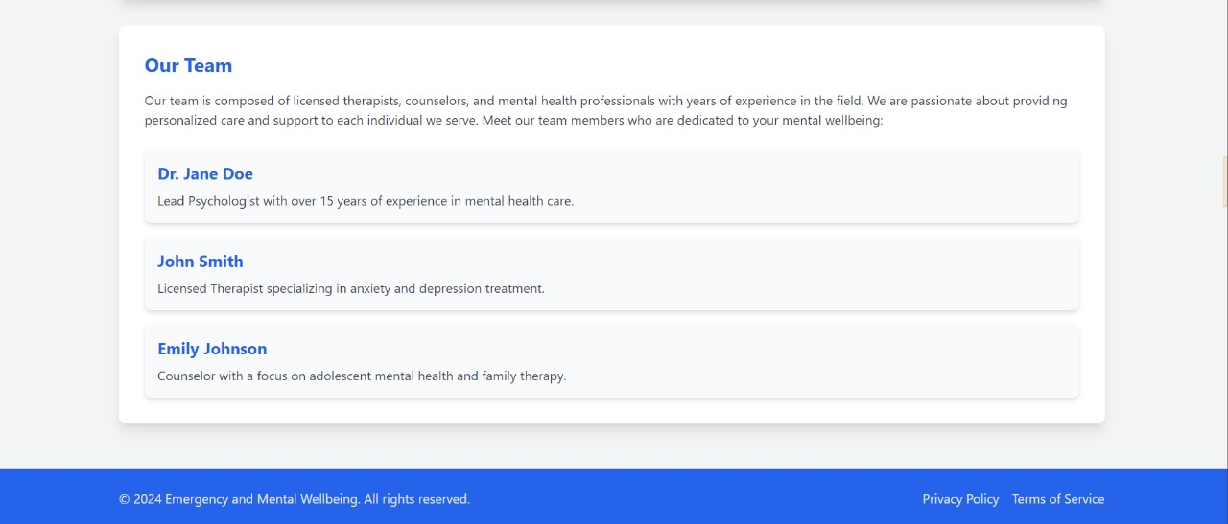
About Page

Slide 27
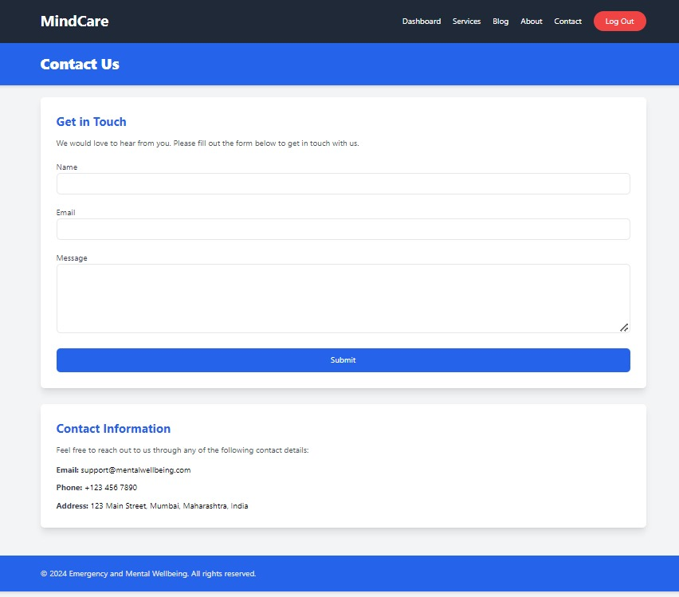
Contact Us Page

Slide 28
Workflow of User
Home Page: Access the landing page with an overview of services and features.
Register: Create a new account by providing necessary details.
Login: Sign in with credentials to access personalized features.
Dashboard: View a personalized dashboard with mood tracking, tasks, and motivational content.
Check Out Services: Explore and utilize features like daily tasks, exercise tasks, and mood tracking.
Add Emergency No: Enter and save an emergency contact number for quick SOS alerts.
SOS: Trigger an emergency SOS alert to the registered contact.
Log Out: Safely log out from the application.

Slide 29
Workflow of Consultant
Register/Login: Sign up or log in to access the consultant's panel.
Dashboard: Manage appointments, view client information, and access consultant tools.
Check Clients' Appointments: View and manage scheduled consultations with clients.
Settings: Configure account preferences and update personal details.
Log Out: Safely log out from the consultant portal.

Slide 30
Mission and vision
Mission
Vision
To empower individuals by providing accessible tools and resources for managing emergencies, enhancing mental well-being, and fostering a supportive and balanced lifestyle.
To create a comprehensive platform that bridges the gap between mental health support and emergency assistance, promoting resilience, positivity, and overall well-being for a healthier, happier society.

Slide 31
“This project aims to bridge the gap between individuals in need and mental health professionals or emergency responders through innovative technology, ensuring seamless, reliable, and timely support for overall well-being and safety.”

Slide 32
Thank You !

